Slide 1
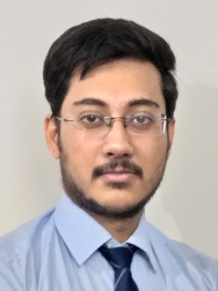



Soumyajeet Kabi
Analyst/Software Engineer
Bachelor of Technology
Computer Science : 2018-2022
Skills
Java 8 /J2EE | Java Basics, OOPS, Generics, Collections, Arrays, Loops, Lambda Exp, Stream API Junit, Mockito, Servlets
Spring core | IOC & Dependency Injections
Spring REST | REST controllers, Implementation of GET, POST, PUT & DELETE, Bean Validation & Exception Handling, Testing Services, Controller & Repository layer
Spring Data JPA | Implement DAO layer using spring Data repositories, Transaction Management
Spring Boot Microservices | Spring Boot Starters, annotations, Messaging Service, Sync/Async comms, Swagger API documents
React | Components, Hooks, Event handling, Redux, Reducers, Testing using Jasmin & Karma
Database | MongoDB No Sql Basics My SQL RDS Basics
UI Tech | HTML 5 & CSS 3,JavaScript, ES6 & TypeScript Reusable templates, Optimized UI Designed
Tools | Git, Postman, Maven, IDE, STS
Add On skills | Communications, Team management. Peer learning , Team Leader, Problem Solving
Bangalore
soumyajeetkabi12@gmail.com
+91 7407019972
A4
Full Stack Developer
Hands on experience in creating microservices with Springboot, Spring Security, Spring Cloud API Gateway, Eureka server, load balancing.
Proficient in creating Single page Web Application in React with Authentication with route guards, React reactive forms, Redux, routing, Tailwind CSS
Hands on experience in implementing Microservices architecture with spring boot
Agile Software Development
Hands on experience in implementing MongoDB.
Basic knowledge of Cloud.
Basic knowledge of AWS.
E-Commerce Shopping Cart Application
Completed end to end case study of Shopping Cart Application using HTML 5, CSS 3 with bootstrap 4, JavaScript ES6, PostgreSQL, React js, Redux, Typescript, Git.
Online Hotel Management System
The Reservation System using and creating microservices with Springboot, Spring Security, Spring Cloud API Gateway, Eureka server, Swagger, HTML 5, CSS 3 with bootstrap 4, JavaScript, React js.
Check out my work on GitHub & Video Profile

